Slide 1






MINI PROJECT
EC-681
GROUP-15
Ruparna Saha
Shivam Kumar Biswas
Vikas Viswakarma
Rohit Kumar Sharma
11500321055
11500321043
11500321048
11500321086

Slide 2



HUMIDITY AND TEMPERATURE SENSING DEVICE

Slide 3
PROJECT OVERVIEW
Humidity and temperature devices are essential for monitoring and maintaining optimal environmental conditions. They ensure comfort, health, energy efficiency, and safety in homes, workplaces, and various industries. Monitoring humidity prevents mold growth and material damage, while tracking temperature aids in controlling energy usage and optimizing processes.

Slide 4
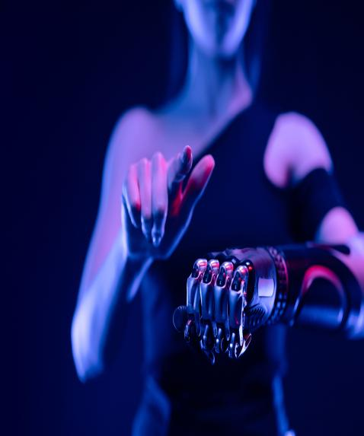

COMPONENTS
•ESP8266 D1 Mini v2 Microcontroller
•DHT11 Digital Temperature & Humidity Sensor
•170 pts Mini Breadboard
•OLED SPI Display Module
•Miscellaneous

Slide 5



BUDGET
•ESP8266 D1 Mini v2 Microcontroller - 200
•DHT11 Digital Temperature & Humidity Sensor - 175 x 2
•170 pts Mini Breadboard - 30
•OLED SPI Display Module - 250
•Miscellaneous - 50
TOTAL COST – 900RS

Slide 6


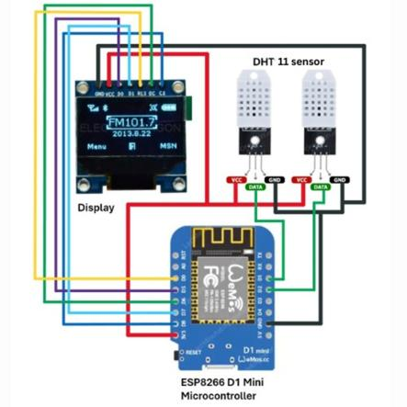

CIRCUIT DIAGRAM

Slide 7
PO / PSO MAPPING
1: SLIGHT (LOW)
2: MODERATE (MEDIUM)
3: SUBSTANTIAL (HIGH).
IF THERE IS NO CORRELATION, PUT “-”

Slide 8
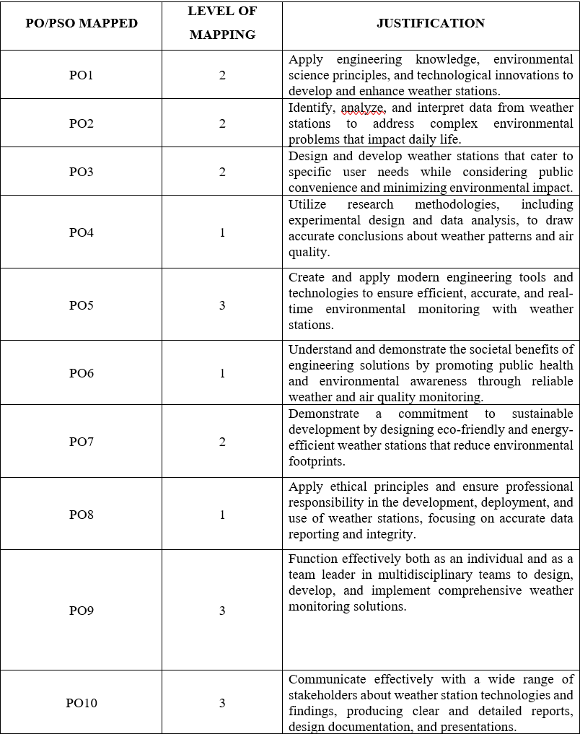
JUSTIFICATIONS OF MAPPING:

Slide 9
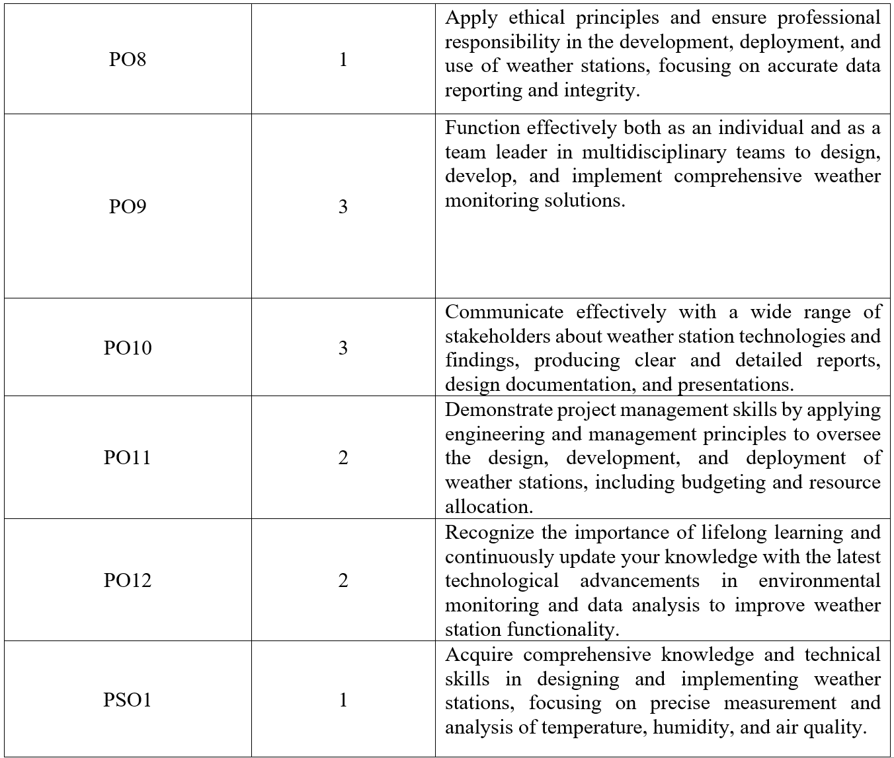
JUSTIFICATIONS OF MAPPING:

Slide 10
Home Environment: Monitor indoor climate to ensure comfort and health.
Agriculture: Track greenhouse conditions to optimize plant growth and crop yield.
Industrial Applications: Maintain optimal environmental conditions in manufacturing and storage facilities.
Weather Tracking: Collect local weather data for amateur meteorologists or educational projects.
Scope of the Project:

Slide 11

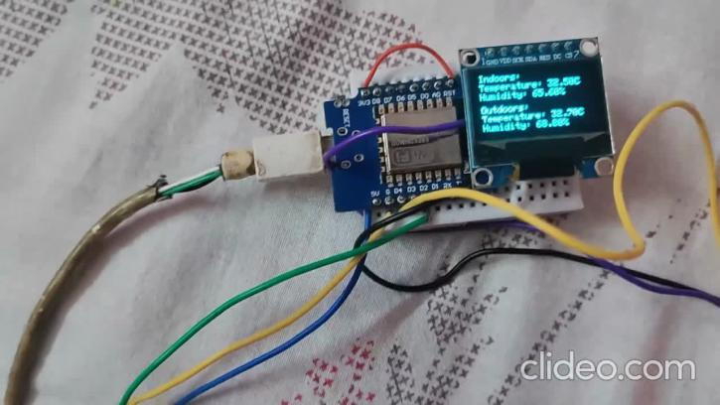

DEMONSTRATION VIDEO:

Slide 12

FUTURE PLAN:
FUTURE IMPROVEMENTS FOR THE WEATHER STATION COULD INCLUDE ADDING SELF-CALIBRATING SENSORS TO ENSURE ACCURACY OVER TIME, USING ADVANCED DATA ANALYSIS TOOLS TO PREDICT WEATHER PATTERNS, AND DESIGNING MORE USER-FRIENDLY INTERFACES. INTEGRATING THE WEATHER STATION WITH RENEWABLE ENERGY SOURCES LIKE SOLAR PANELS CAN MAKE IT MORE SUSTAINABLE. ENHANCING MOBILE APP FEATURES TO PROVIDE CUSTOMIZABLE ALERTS AND DETAILED DATA VISUALIZATION WILL IMPROVE USER EXPERIENCE.
EXPANDING THE STATION TO INCLUDE MORE SENSORS FOR POLLUTANTS LIKE CARBON MONOXIDE AND VOCS COULD OFFER A FULLER PICTURE OF AIR QUALITY. OVERALL, THIS PROJECT SHOWS HOW ENGINEERING AND TECHNOLOGY CAN EFFECTIVELY MONITOR ENVIRONMENTAL CONDITIONS, HELPING USERS MAKE BETTER DECISIONS FOR THEIR COMFORT, HEALTH, AND SUSTAINABILITY EFFORTS.

Slide 13
THANK YOU!

